Slide 1

Predicting customer buying behavior

Slide 2
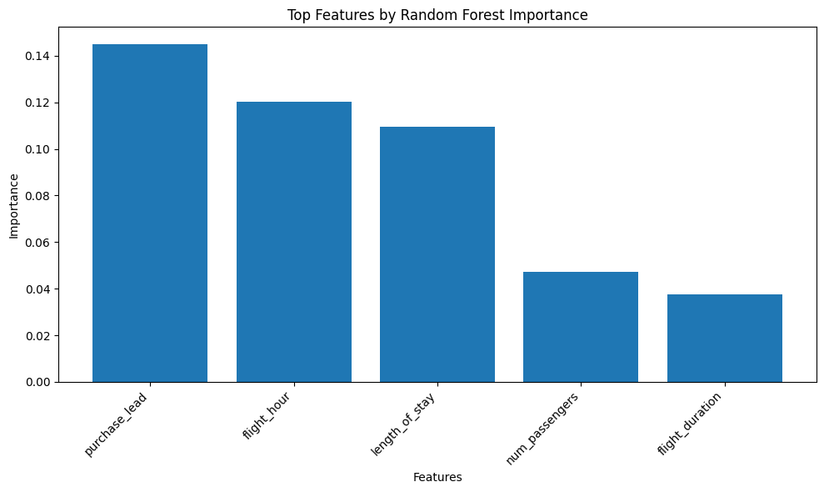
Prediction model Summary
Objective: Predict booking completion based on various factors of flight bookings.
Dataset: Airline booking data provided had a total of 50,000 samples and 14 features.
Models Tested: Random Forest, SVM and KNN
Best Prediction Model: Random Forest
Performance:
Accuracy: 85.2%
Precision: 53%
Key Features:
purchase_lead
flight_hour
length_of_stay

